Slide 1

Richard Brynteson, Skype and Teams MVP, MCSM t: @rbrynteson w: theargylemvp.com m: mixer.com/DJ_LordCabbage
Teams Meeting Experience

Slide 2
Agenda
Level Set The Room
Demo
What’s Next

Slide 3
Types of Meetings

Slide 4
Three Types of Meeting + One More…
Scheduled Meetings
Created in Teams or Outlook
Can be one time or recurring
Pre/During/Post Experience
Channel Meetings
Created in Teams Only
Can be one time or recurring
Pre/During/Post Experience
Ad Hoc
Created in Teams Only
Single Occurrence started from Channel Post or Group Chat
Only During/Post Experience
Live Events
Created in Teams
One Time Events
Large Meeting Hall Experience

Slide 5
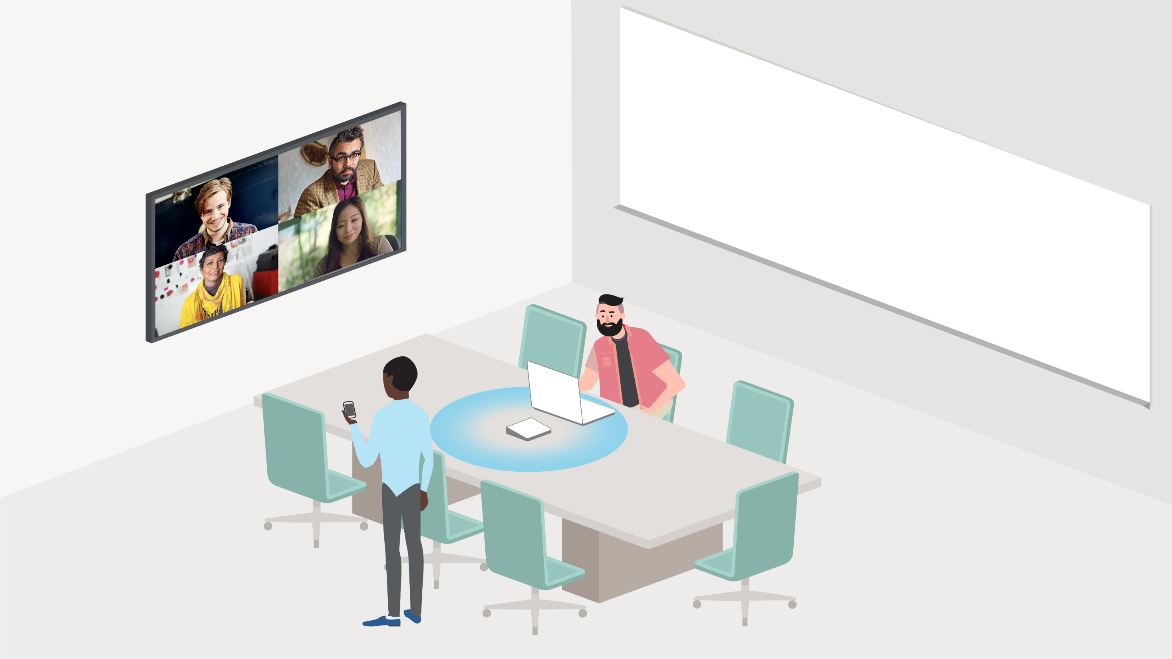
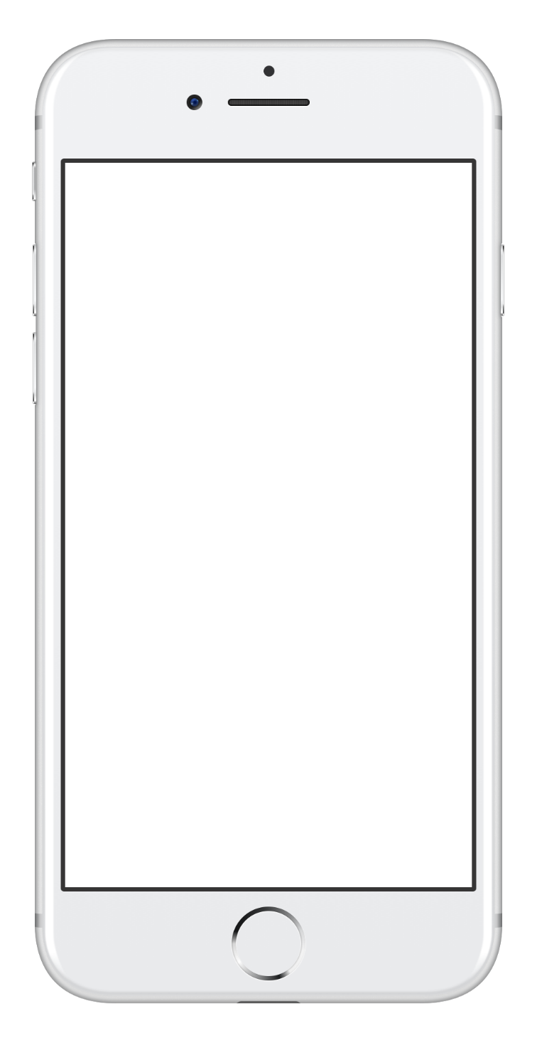
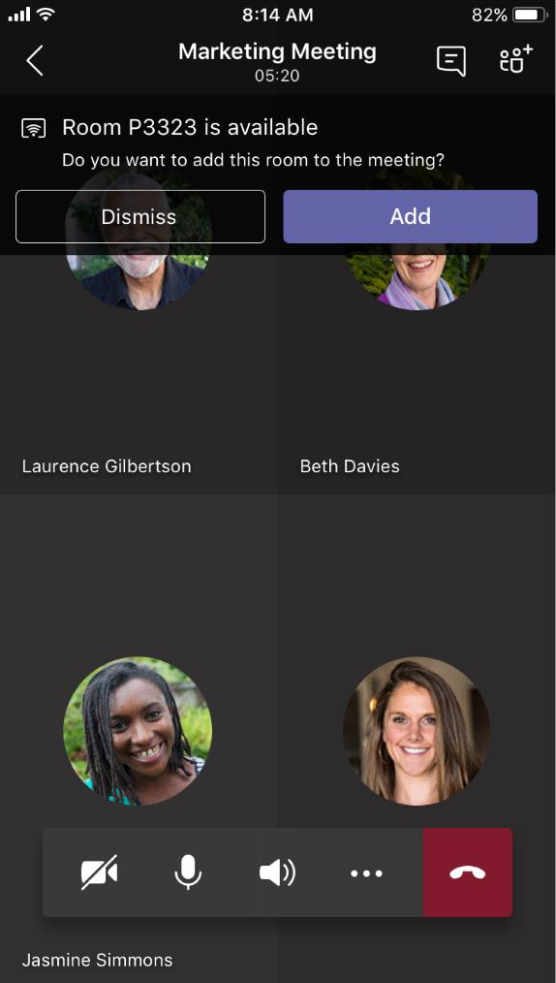
Proximity based meeting join
Comps

Slide 6
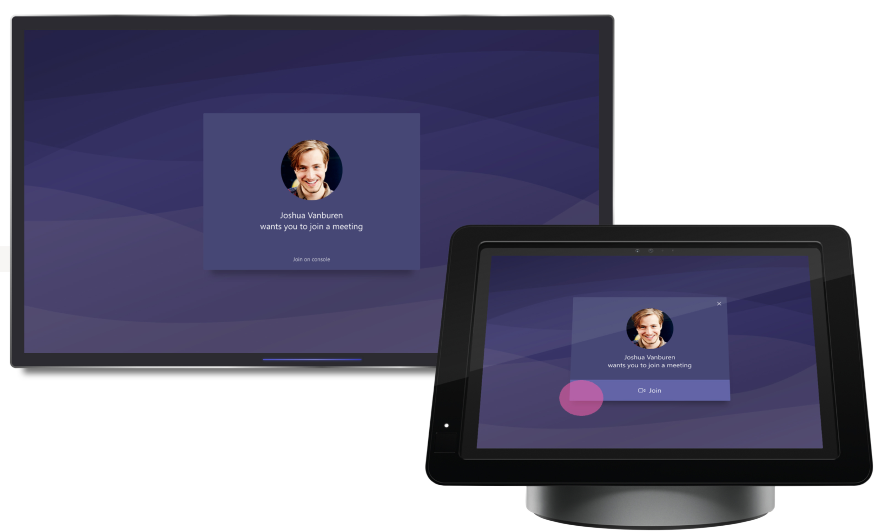
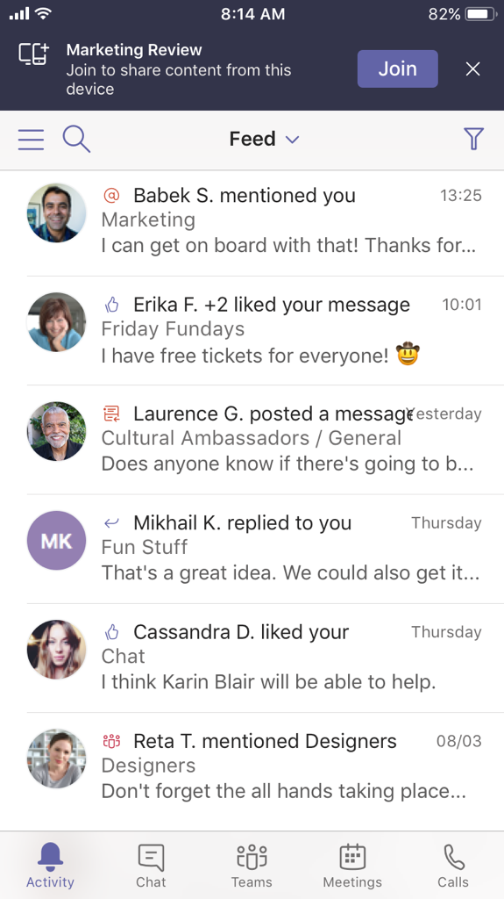
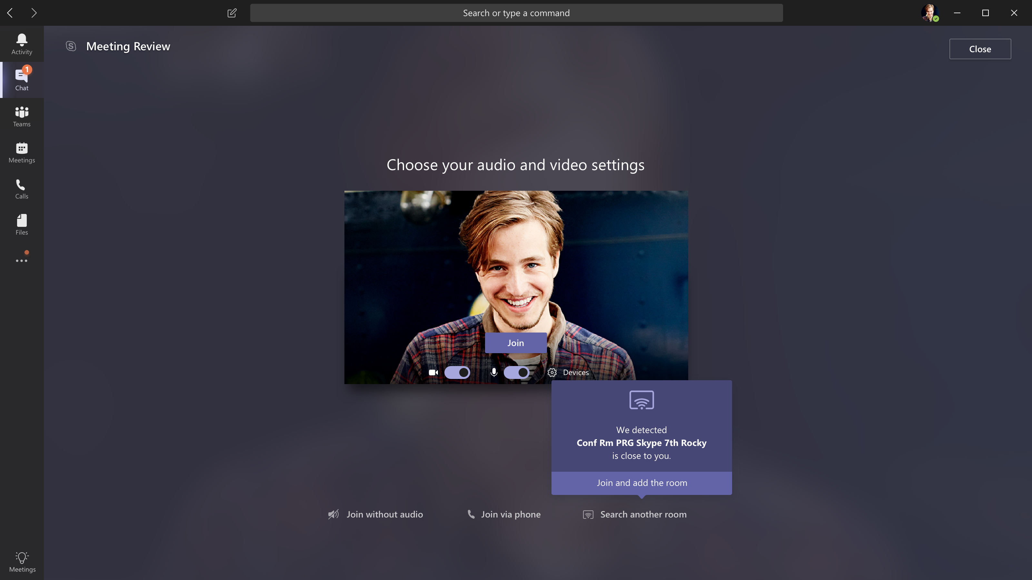
Proximity beaconing
When a Teams app on a PC or mobile device is close to an available Room, the proximity sensor in the Teams app detects the MTR in the meeting room, and can add MTR to the meeting as a participant.
Inside the meeting room, the FOR and console will show that you are trying to add the room, and a user will have to accept the incoming invitation on the console to bring the room system into the meeting.
The PC or mobile app will automatically go into content-only mode allowing the room to provide audio & video into the meeting without echo and feedback generated by the other clients in the room.

Slide 7
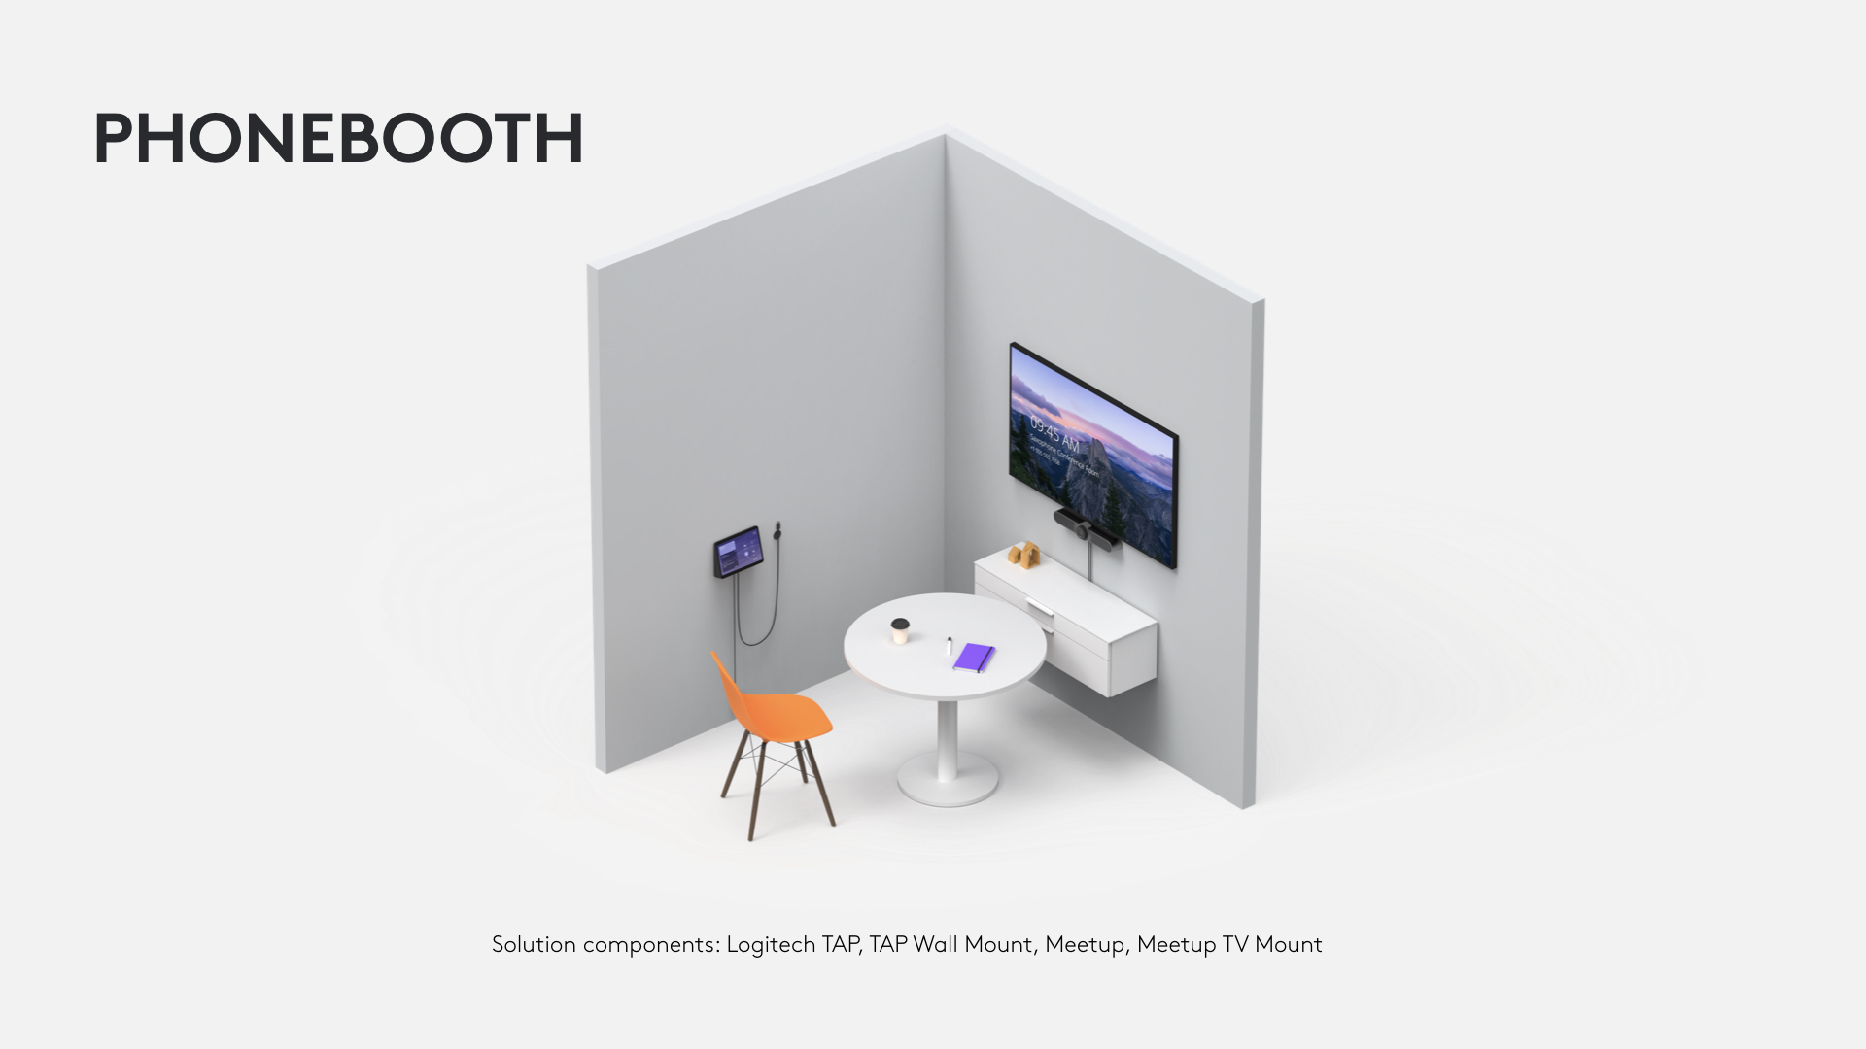
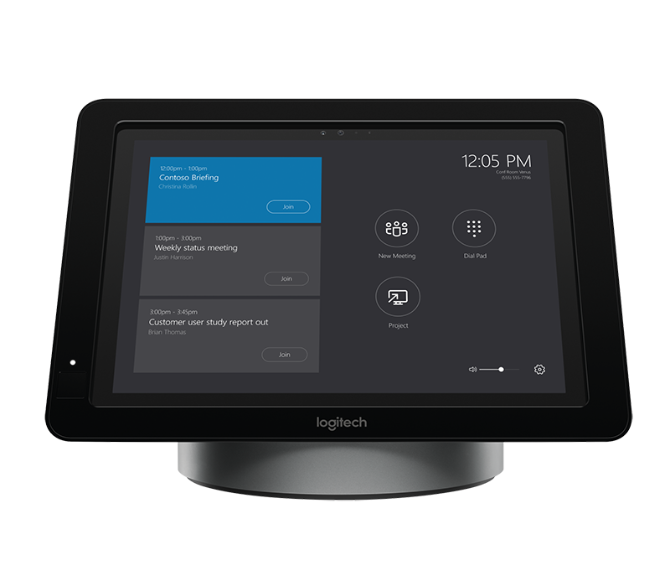
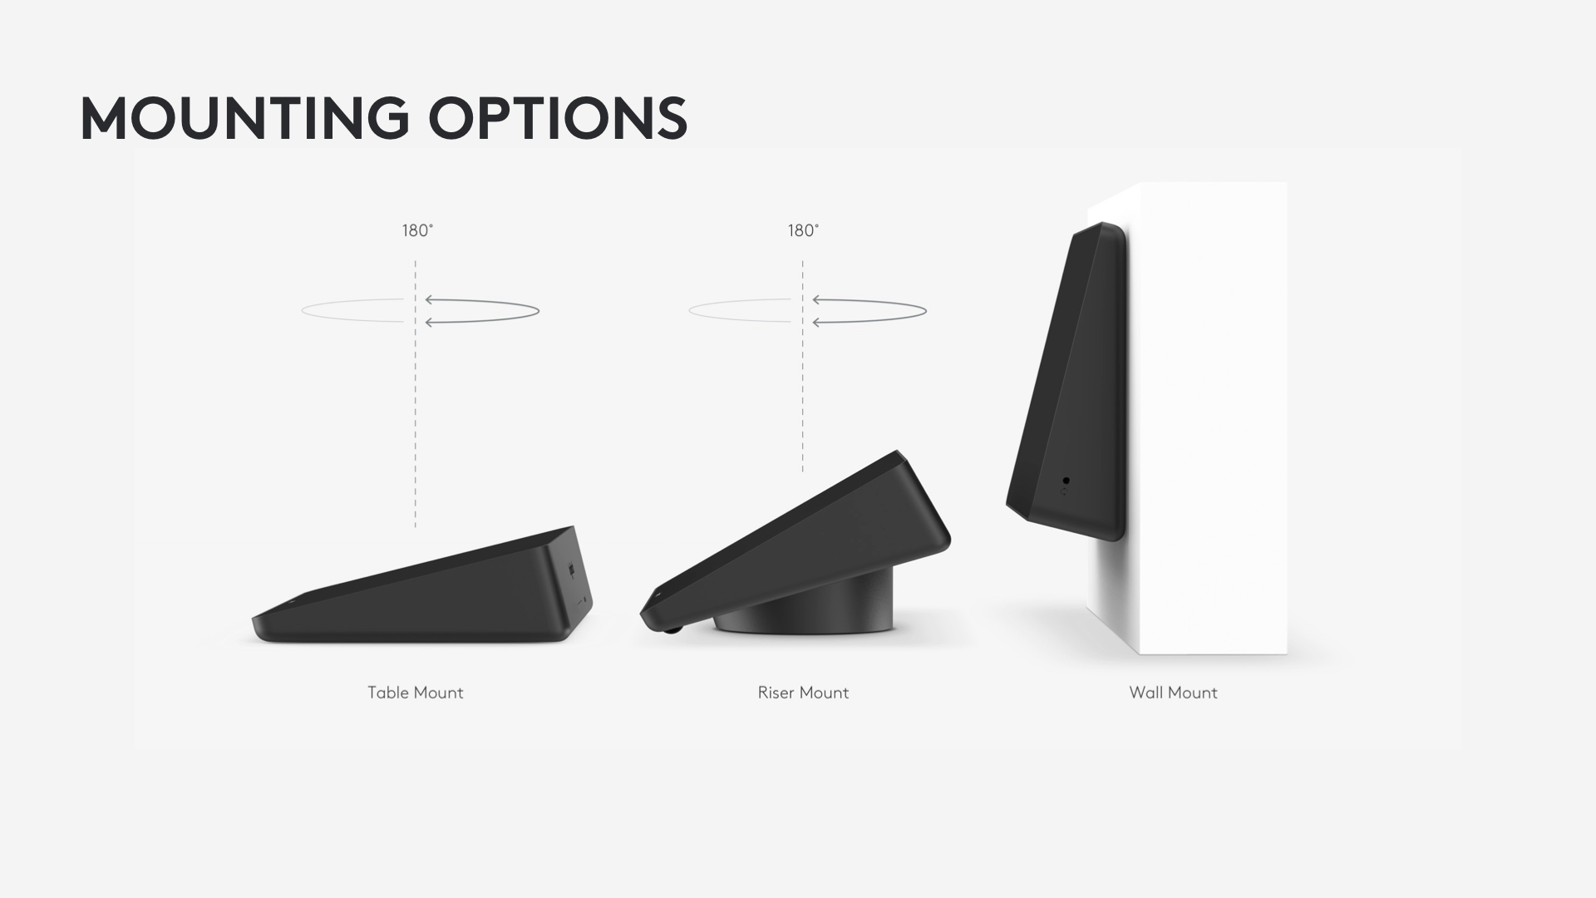
What Do I Need For Proximity
Microsoft Teams Room (MTR) formally known as Skype Room System

Slide 8


Companion experiences
Connect personal and meeting-room devices to share content and control the meeting
Check in and join in content-only mode
Share live videos, photos, or the screen from your mobile device
Maintain a consistent experience in Teams across devices

Slide 9
What Makes It So Cool
Works anywhere! Mobile, Desktop
Integrates with SfB. Third party results in a disconnected experience
Recording is simple.
Accessibility features.
Pre/During/Post Experiences
Speed
Blur
Recording
Notes
Quality

Slide 10
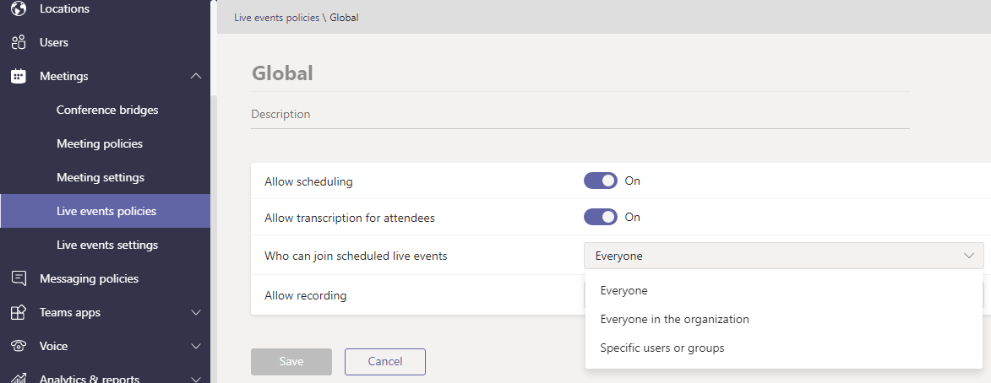
Live Event Policies
Who can schedule – who can join!!!

Slide 11
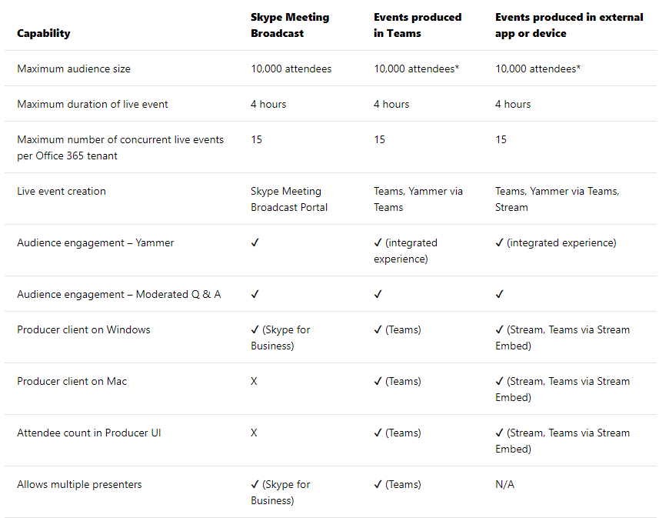
Teams Live Events
SIP Trunk

Slide 12
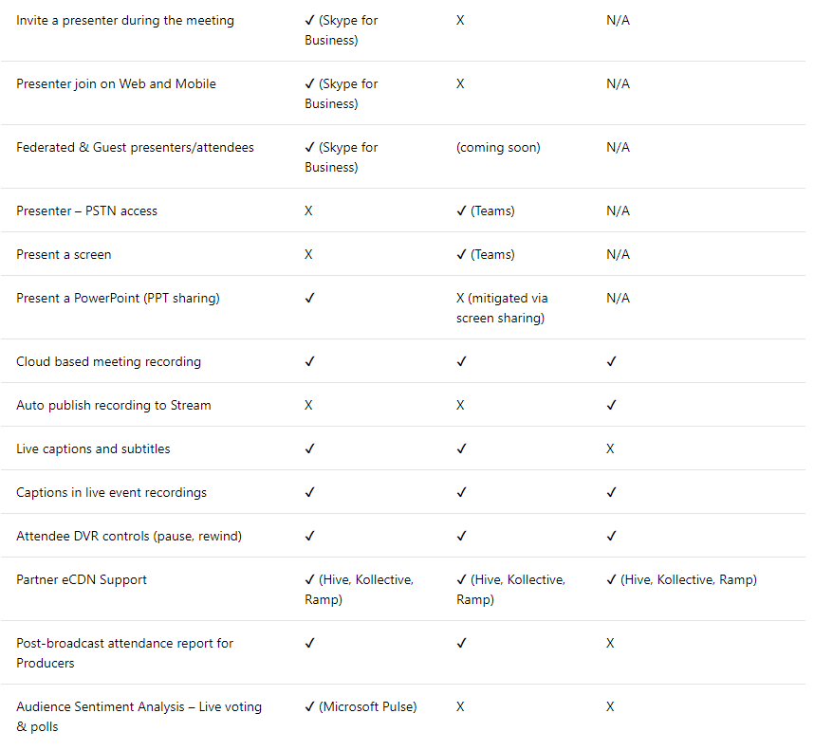
SIP Trunk

Slide 13
What’s Next!!!
What are the features we can look forward too in the near to someday in the future?

Slide 14
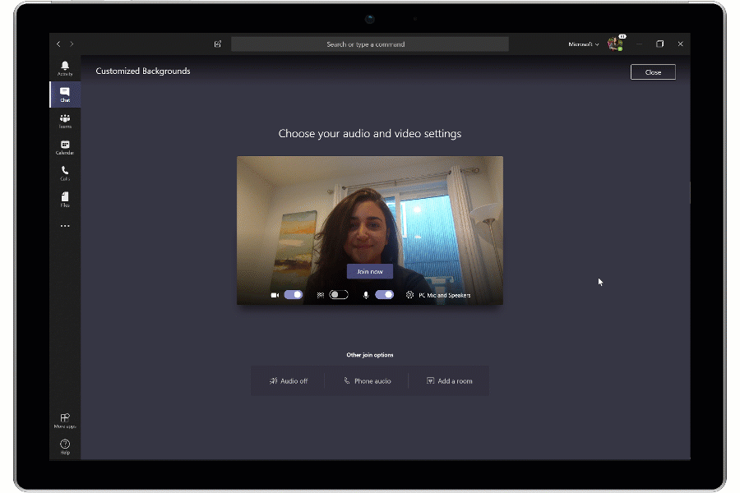
Background Replace

Slide 15
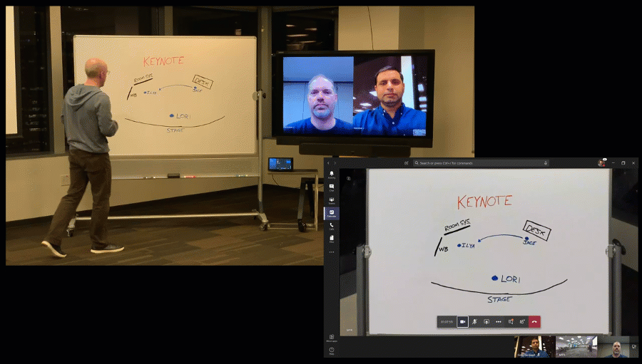
Magic Whiteboard

Slide 16
And More
Chrome Meeting Experience
See Video, App and Desktop Sharing without plug-in
Meetings First
The best solution for enterprises using Skype for Business for Enterprise Voice
Remember, it’s just Online going away. On-Premises customers using EV are safe.
More Meeting Devices
Logitech Tap. Poly and Yealink solutions.
More Streams
Shown at Enterprise Connect having 9 video streams
Auto Mute
Join with more than 7 people, we come in auto-muted

Slide 17
Planned Per User Voice
Microsoft LOVES to use User Voice. Make sure to make your voice heard!!!
https://microsoftteams.uservoice.com
Export list of users who attended a meeting
Video Pinning
Speech to Text Meeting Notes (extension of Stream)
Disable chat notifications during meetings
Raise your hand
Presenter Policies
PowerPoint Recording

Slide 18
Minnesota Teams/Skype Users Group
Meeting six times a years, third Thursday of each month.
Our next meeting is August 15th from 9AM to 11AM here at the MTC.
Agenda
Teams Enterprise Voice (Calling)
Skype for Business CU1
Teams Management
PowerShell, Graph and more
Register at https://www.meetup.com/mnteams/

